Slide 1
Unit VI: Ch. 12 & 13 (Sect. 1 & 2)
The South Expands:
Slavery and Society 1820—1860
&
The Crisis of Union
1820—1860

Slide 2
Slavery and the Impeding Crisis of Union
From 1775 to 1830, many African Americans gained freedom from slavery, yet during the same period the institution of slavery expanded. Explain why BOTH of those changes took place.

Slide 3
1775 to 1830
Revolutionary War
Framing the Constitution
The Early Republic (GW—Monroe)
(Era of Good Feelings)
Age of Reform
Age of Jackson

Slide 4
Characteristics of the Antebellum South
Primarily agrarian.
Economic power shifted from the
“upper South” to the “lower South.”
“Cotton Is King!”
* 1860→ 5 mil. bales a yr.
(57% of total US exports).
Very slow development of industrialization.
Rudimentary financial system.
Inadequate transportation system.

Slide 5
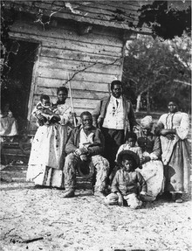
Slavery & The Expanding South
By 1817 the southern plantation system was rapidly expanding.
Cotton was THE cash crop.
America had begun to expand out west - more open land to come.
    Louisiana Purchase
    Adams-Onis Treaty
    Indian removal
    Annexation of Texas (TBA)
More land & more cotton production meant more $$$$, thus the result was an increase in the need/demand of slave labor.

Slide 6
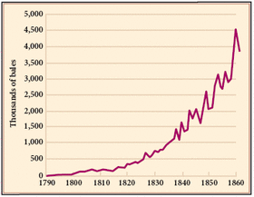
Cotton Production

Slide 7
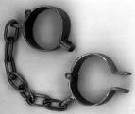
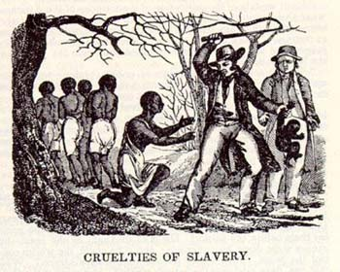
Slave Trade
The cotton boom brought about an increase in slave trade.
African American population was growing rapidly, from natural increases.
Congress outlawed the Atlantic Slave Trade, but illegal importing still took place.
Other alternative was Domestic slave trade:
a) costal system
b) inland trading
Domestic Slave trade was crucial to the southern economy remaining prosperous.

Slide 8
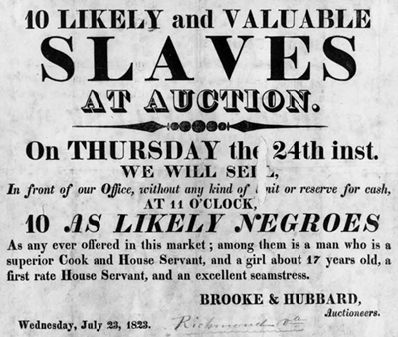
Slave Auction Notice, 1823

Slide 9
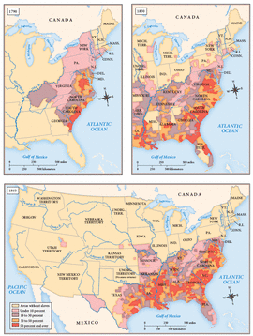
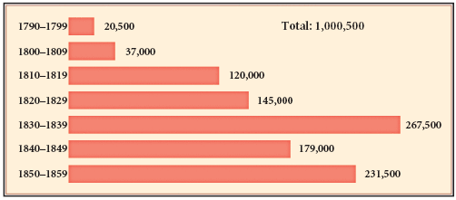
Redistribution of Slavery
1790-1860
The cotton boom that began in the 1810s set in motion a great redistribution of the African American population. Between 1790 and 1860, white planters moved or sold more than a million slaves from the Upper to the Lower South.

Slide 10
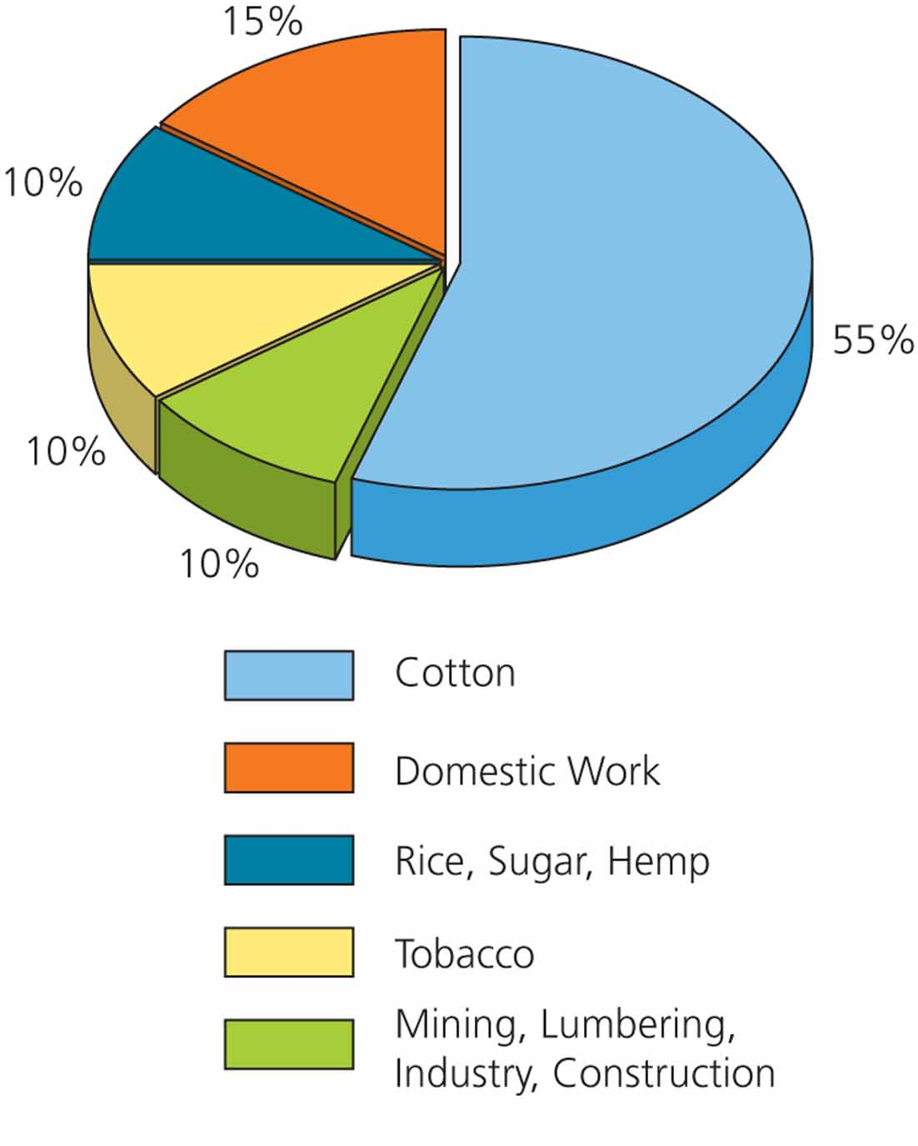
Distribution of Slave Labor in 1850

Slide 11
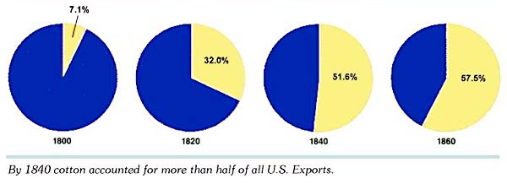
Value of Cotton Exports
As % of All US Exports

Slide 12
Defending Slavery
Economic
    Demanding crop with long growing season
    Market boom brought high demand
    There is money to be made
    Slaves were socially inferior economic competitors
Moral
    A supportive social system
    Christian ideology was the root of the community
    Slaves were required to attend religious services
    Offered them a decent lifestyle
    Low % of people owned slaves (by 1860 >25%)

Slide 13
SLAVE SOCIETY & CULTURE

Slide 14
The Faith of African Americans
See Ch. 12, section 2!

Slide 15
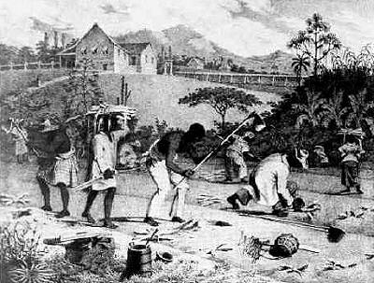
Slave Revolts & Resistance
Planters constantly worried about the outbreak of slave rebellions and/or resistance.
Slaves could slow the pace of work by breaking tools, faking illnesses or running away.
Fear of resistance reduced a masters the use of violence

Slide 16
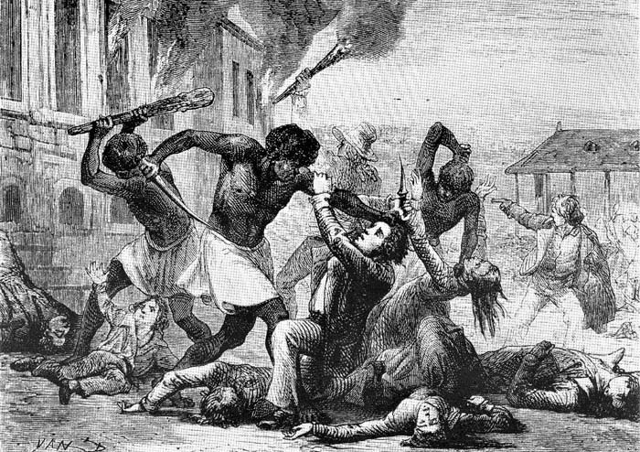
Gabriel’s Rebellion--1800
Gabriel Prosser planned to create a huge army of escaped slaves and eventually take over the Governor’s mansion – forcing him to accept their demands.
Didn’t work –two slaves sold him out. He was captured, tried and convicted, and finally executed.

Slide 17
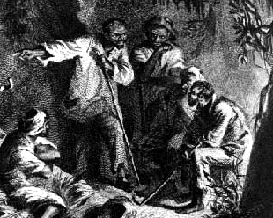
Slave Rebellions
Nat Turner—1831
Claimed that he had been chosen by God to lead the slaves to freedom.
August 21 – Nat and 6 other slaves killed the Travis family. He gathered 75 other slaves, killed 51 whites.
Hid for 6 weeks, was hanged in Jerusalem, VA.

Slide 18
Slave Codes
Denied the right to vote
Denied the right to a trial by jury
Could not testify against whites
Children could not attend public schools
Had to carry passes to prove that they were free
Could not gather without a white person
No groups of more than 3 Negroes could gather

Slide 19
More Slave Codes
Cannot own a gun
Marriages not legally recognized
No alcohol
Illegal to teach slaves to read or write
Legalized homicide as “punishment”

Slide 20
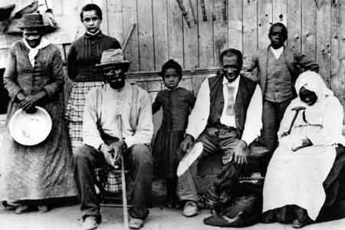
Free Black Population
1790 – proportion of free blacks in total black population was 8%
By 1840 it became 13%.
Half of free blacks lived in the North.
Most whites viewed free blacks as socially inferior and economic competitors.
Only a few states allowed free black men to vote, attend public schools, and attend white churches

Slide 21
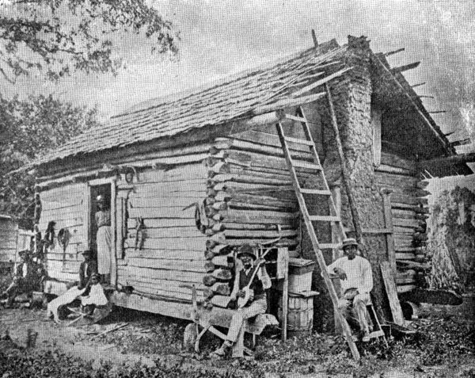
Free Black Population contd..
Most free blacks in the South lived in large coastal cities.
Free southern blacks accused of crimes were often denied a jury trial and forced back into slavery.
Free blacks had to possess freedom papers

Slide 22
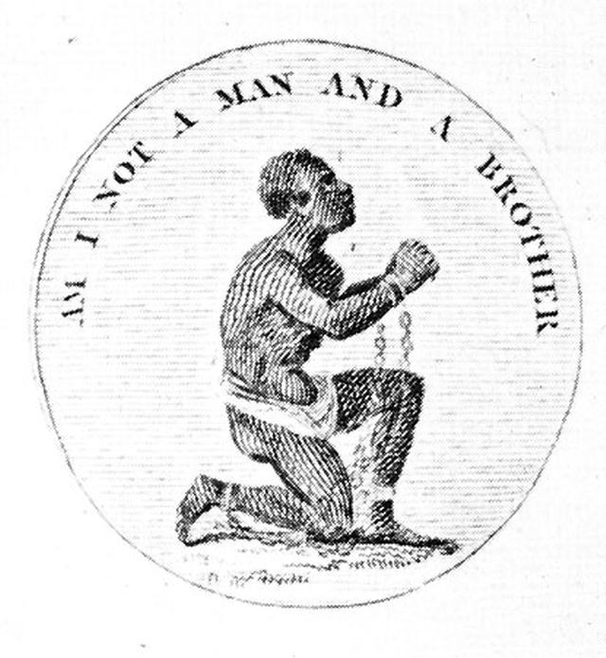
The Abolitionist Movement
1816 → American Colonization Society
created (gradual, voluntary
emancipation).

Slide 23
Abolitionist Movement
Create a free slave state in Liberia, West
Africa.
No real anti-slavery sentiment in the North
in the 1820s & 1830s.
Gradualists
Immediatists

Slide 24
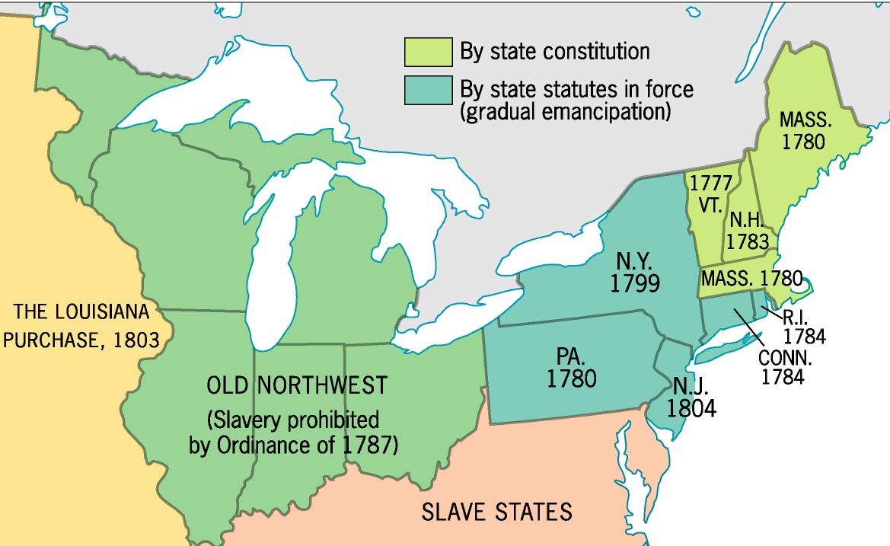
Early Emancipation in the North

Slide 25
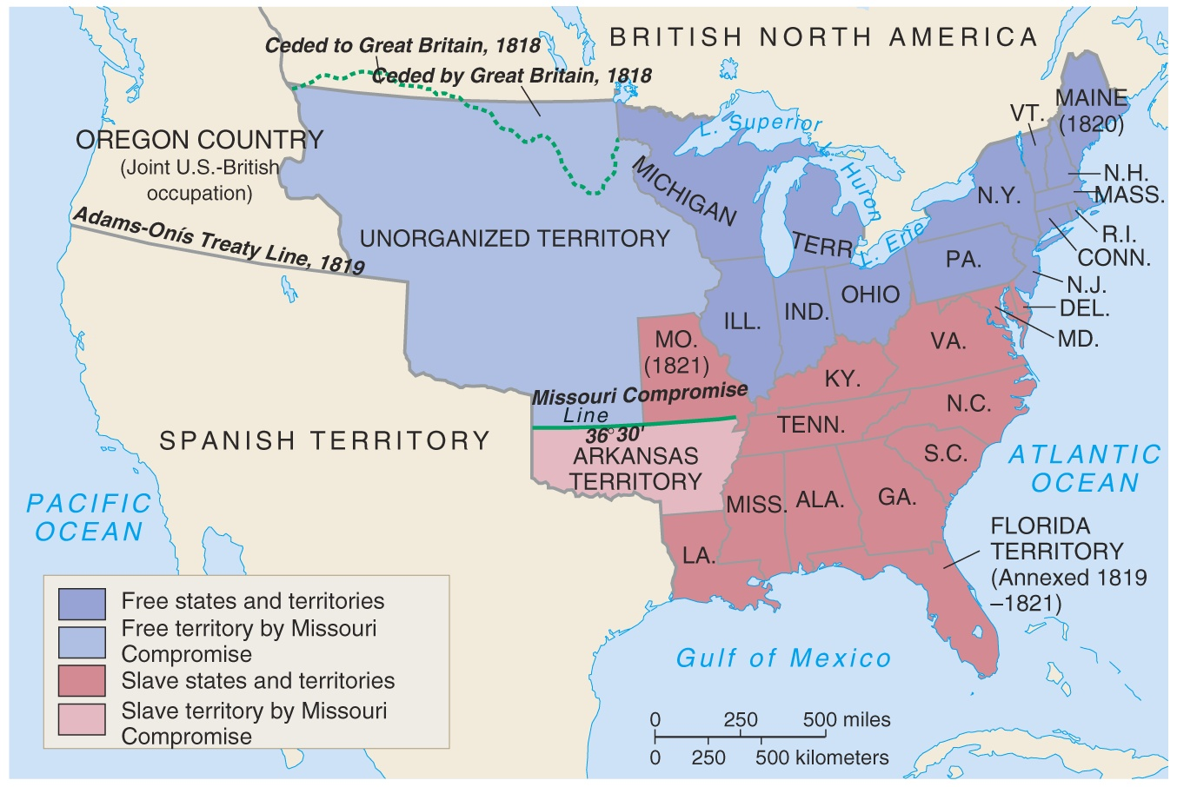
Missouri Compromise, 1820

Slide 26
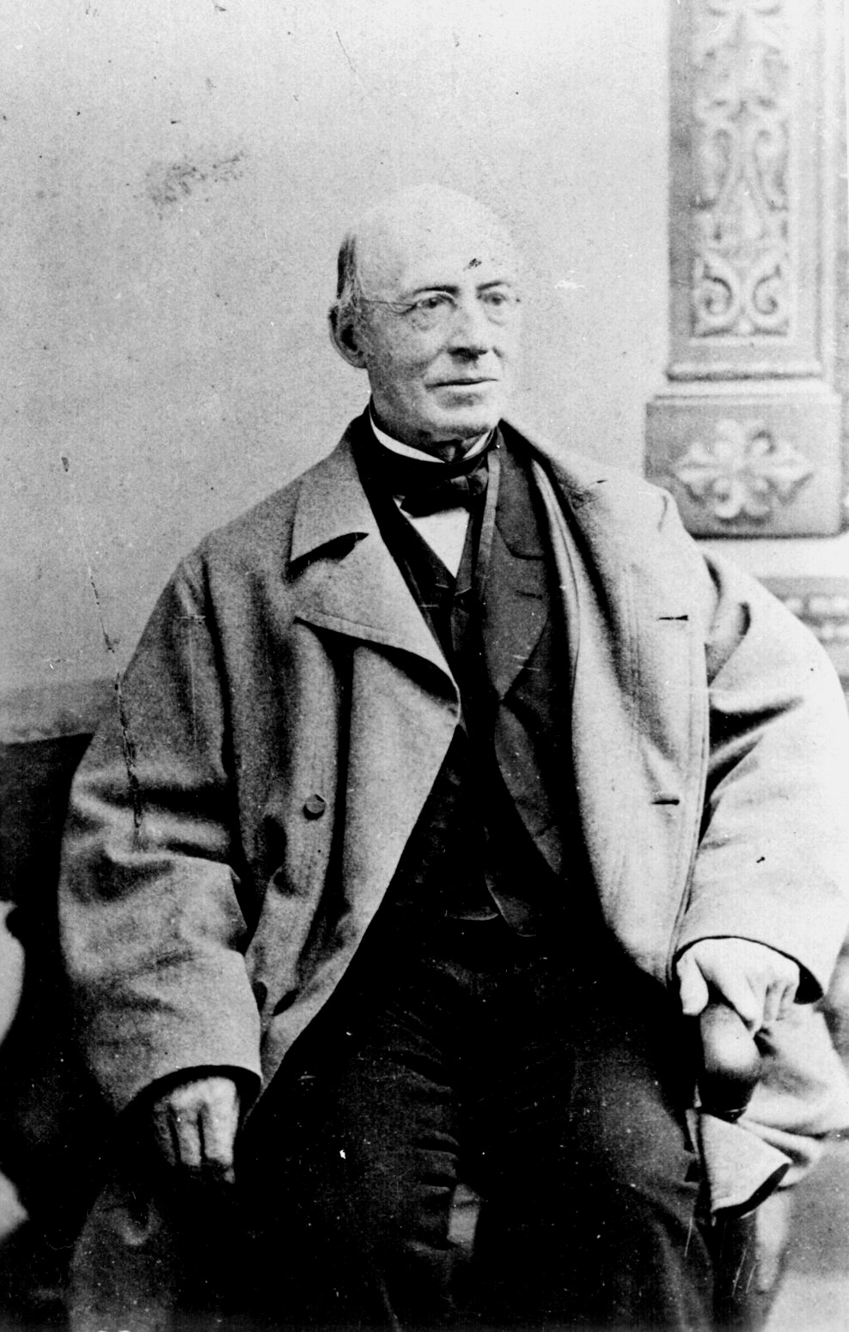
William Lloyd Garrison
(1801-1879)
Slavery & Masonry
undermined republican
values.
Immediate emancipation
with NO compensation.
Slavery was a moral, not
an economic issue.
R2-4

Slide 27
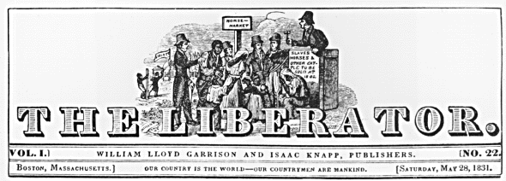
The Liberator
Premiere issue → January 1, 1831
R2-5

Slide 28
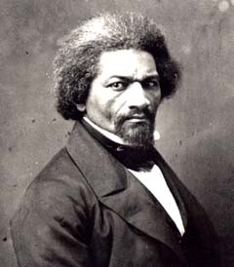
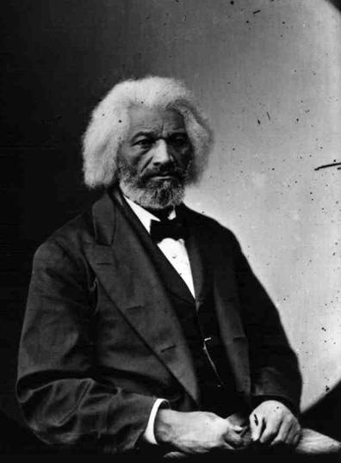
Frederick Douglass (1817-1895)
1845 → The Narrative of the Life
Of Frederick Douglass
1847 → “The North Star”
R2-12

Slide 29
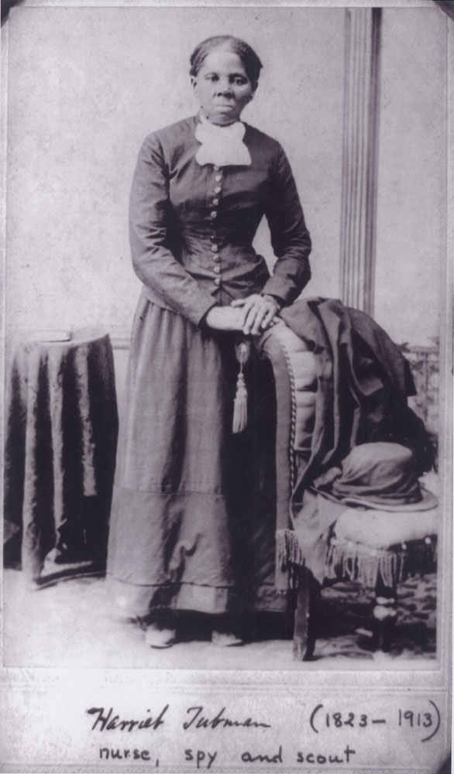
Harriet Tubman
(1820-1913)
Helped over 300 slaves to freedom.
$40,000 bounty on her head.
Served as a Union spy during the Civil War.
“Moses”

Slide 30
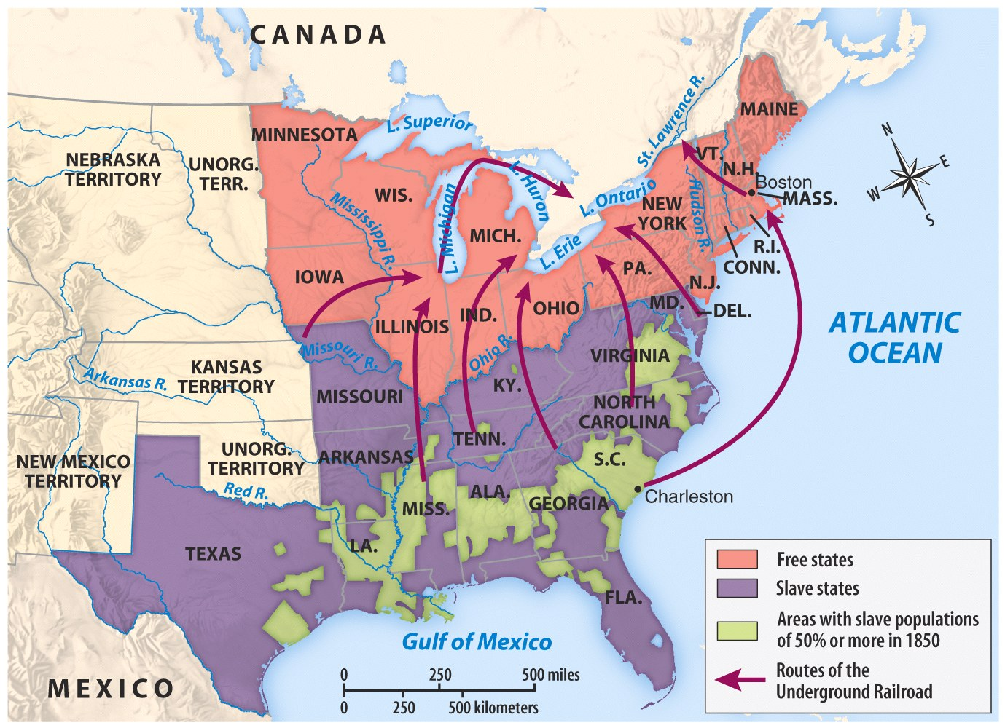
The Underground Railroad

